Slide 1



Python Tutorial Series Your codes pretty and healthy
PhD Bruno C. Quint
bquint@ctio.noao.edu
Resident Astronomer at SOAR Telescope

Slide 2
What does make scientific software usable for long time?

Slide 3
What does make scientific software usable for long time?
Code documentation
Final user documentation
Friendly interface
Version coherence
Code readability
Error handling
Version Control
Scientific Impact

Slide 4
What does make scientific software usable for long time?
Code documentation
Final user documentation
Friendly interface
Version coherence
Code readability
Error handling
Version Control
Scientific Relevance

Slide 5
Why do we keep NOT doing these?
Documentation
Clear Code
Error & Version Track

Slide 6
The Zen of Python

Slide 7
The Zen of Python
>>> import this

Slide 8
The Zen of Python
>>> import this
Beautiful is better than ugly.
Explicit is better than implicit.
Simple is better than complex.
Complex is better than complicated.
Flat is better than nested.
Sparse is better than dense.
Readability counts.
Special cases aren't special enough to break the rules.
Although practicality beats purity.
Errors should never pass silently.
Unless explicitly silenced.
In the face of ambiguity, refuse the temptation to guess.
...
15/02/2017

Slide 9
The Zen of Python
>>> import this
...
There should be one -- and preferably only one –
obvious way to do it.
Although that way may not be obvious
at first unless you're Dutch.
Now is better than never.
Although never is often better than *right* now.
If the implementation is hard to explain, it's a bad idea.
If the implementation is easy to explain,
it may be a good idea.
Namespaces are one honking great idea
-- let's do more of those!

Slide 10
Do the docstring for your life!

Slide 11
Do the docstring for your life!
Last week
Lask week
I will do the docs later nobody will read my code.
Ok. That’s just a small
script, I can write it
once again.
FUUU!! I have no idea of what I’ve done here! It will take forever!

Slide 12
Do the docstring for your life!
Add documentation to your files
#!/usr/bin/env python
# -*- coding: utf-8 -*-
"""
My Sample Code
This is such a simple documentation! The only thing I have to do is to add three single quotes (') or double quotes (") together to start a docstring block! Then just write down in a few words what you want to do in your file.
by J. Bond - Feb 31, 202X
"""

Slide 13
Do the docstring for your life!
Add documentation to your files
#!/usr/bin/env python
# -*- coding: utf-8 -*-
""”The docstring can also be just one line"""

Slide 14
Do the docstring for your life!
Add documentation to methods/classes
def say_hello(name):
"""
This method simply says hello to the person
whose name is given as parameter.
"""
print("Hello, {0}!".format(name))

Slide 15
Do the docstring for your life!
Documentation styles
PEP 257
def say_hello(name):
"""
This method simply says hello to the person
whose name is given as parameter.
:param name: name of the person that to be greeted.
:type name: string
"""
print("Hello, {0}!".format(name))

Slide 16
Do the docstring for your life!
Documentation styles
Sphinx Napoleon
def say_hello(name):
"""
This method simply says hello to the person
whose name is given as parameter.
Parameters
name (string): The name of the person that
will be greeted.
"""
print("Hello, {0}!".format(name))

Slide 17
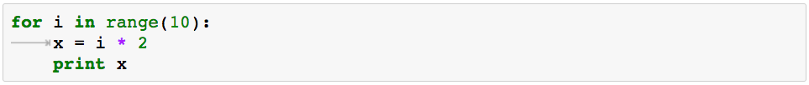
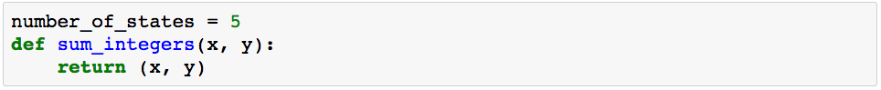
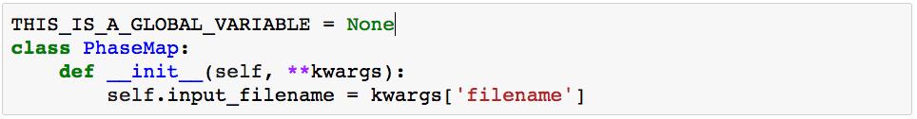
Why write if others can’t read?
Code Style: PEP-8 and/or Google Style
Indentation
Name Notation

Slide 18
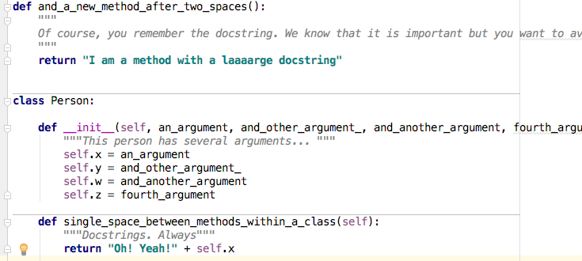
Why write if others can’t read?
Code Style: PEP-8 and/or Google Style
Code Layout

Slide 19
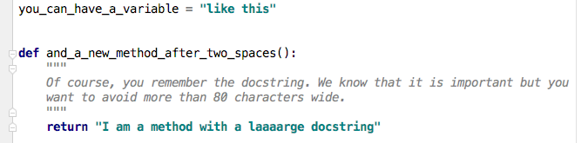
Why write if others can’t read?
Code Style: PEP-8 and/or Google Style
Code Layout – Wrap text within 80 characters (72 for docstrings).

Slide 20
Why write if others can’t read?
Code Style: PEP-8 and/or Google Style
Code Layout – Wrap text within 80 characters (72 for docstrings).
income = (gross_wages
+ taxable_interest
+ (dividends - qualified_dividends)
- ira_deduction
- student_loan_interest)

Slide 21
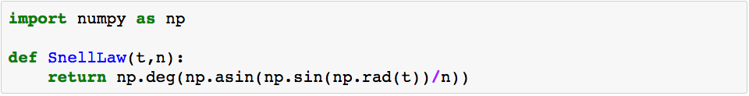
Why write if others can’t read?
Code Style: PEP-8 and/or Google Style
Give some space and use self-explanatory names

Slide 22
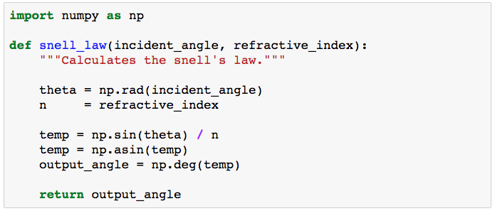
Why write if others can’t read?
Code Style: PEP-8 and/or Google Style
Give some space and use self-explanatory names

Slide 23
Why write if others can’t read?
Code Style: PEP-8 and/or Google Style
Give some space and use self-explanatory names

Slide 24
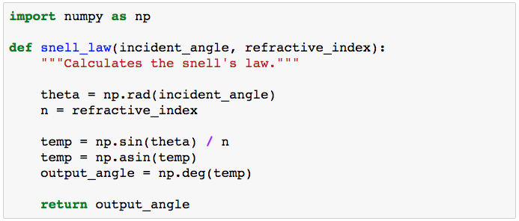
Why write if others can’t read?
Code Style: PEP-8 and/or Google Style
Give some space and use self-explanatory names

Slide 25
Why write if others can’t read?
Code Style: PEP-8 and/or Google Style
Give some space and use self-explanatory names

Slide 26
Why write if others can’t read?
Code Style: PEP-8 and/or Google Style
Give some space and use self-explanatory names

Slide 27
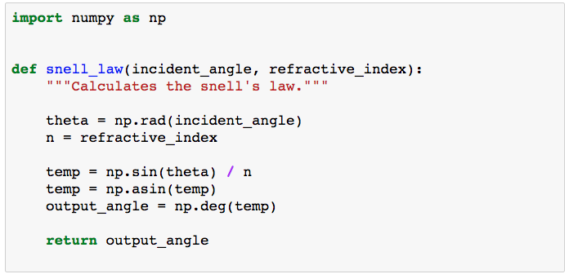
Why write if others can’t read?
Code Style: PEP-8 and/or Google Style
Give some space and use self-explanatory names

Slide 28

Questions?

